Slide 1
PRESENTED BY
DEVATHARSHINI S
au821721104013
BE-CSE
3RD YEAR
devatharshinidevatharshini63@gmail.com
SIR ISSAC NEWTON COLLEGE OF ENGINEERING AND TECHNOLOGY
NAGAPATTINAM – 611 102.

Slide 2
IMAGE CLASSIFICATION USING CONVOLUTIONAL NEURAL NETWORK

Slide 3
AGENDA
Introduction
What is convolutional neural network
Dataset selection and preprocessing
Model architecture
Deployment
Documentation and reporting
Result
Conclusion
References

Slide 4
INTRODUCTION:
Image classification is a complex process that may be affected by many factors. Because classification results are the basis for many environmental and socioeconomic applications, scientists and practitioners have made great efforts in developing advanced classification approaches and techniques for improving classification accuracy. Image classification is used in a lot in basic fields like medicine, education and security. Correct classification has vital importance, especially in medicine. Therefore, improved methods are needed in this field. The proposed deep CNNs are an often-used architecture for deep learning and have been widely used in computer vision and audio recognition. In the literature, different values of factors used for the CNNs are considered. From the results of the experiments on the CIFAR dataset, we argue that the network depth is of the first priority for improving the accuracy.

Slide 5
WHAT IS CONVOLUTIONAL NEURAL NETWORK:
For those of you new to this concept, CNN is a deep learning technique to
classify the input automatically (well, after you provide the right data).
Over the years, CNN has found a good grip over classifying images for
computer visions and now it is being used in healthcare domains too.
This indicates that CNN is a reliable deep learning algorithm for an
automated end-to-end prediction.

Slide 6
DATASET SELECTION AND PREPROCESSING:
Image classification algorithms are trained and tested using image datasets. These are collections of example images similar to those the algorithm will encounter in real life. Supervised models are trained and tested using labeled image datasets these labels provide the “ground truth” the algorithm can learn from.
1. MNIST
The MNIST database of handwritten digits is one of the most classic machine learning datasets. With 60,000 training images and 10,000 test images of 0-9 digits (10 classes of digits), MNIST is excellent for benchmarking image classification models
2. CIFAR-10/100
This dataset is known for its manageability and is composed of 60,000 32×32 color images, neatly divided into 10 classes with 6,000 images per class. Of these, 50,000 serve as the training subset, with the remaining 10,000 earmarked for testing. The CIFAR-10’s moderate size makes it ideal for experiments where computational resources are limited.

Slide 7
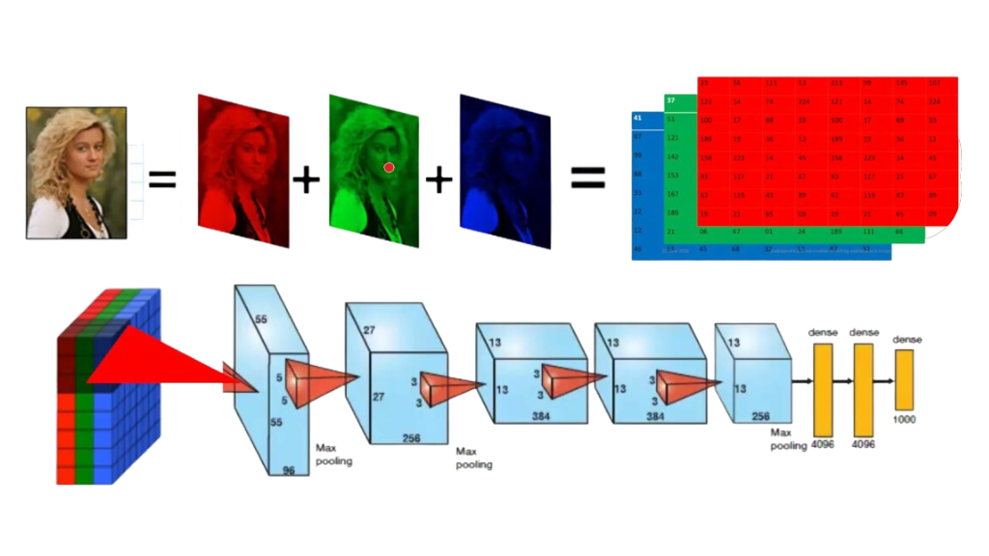
MODEL ARCHITECTURE:
Some of the most popular CNN architectures for image classification include AlexNet, VGGNet, GoogLeNet/Inception, ResNet, and DenseNet. The choice of CNN architecture depends on the specific requirements of the image classification task and the available resources for training and inference.

Slide 8
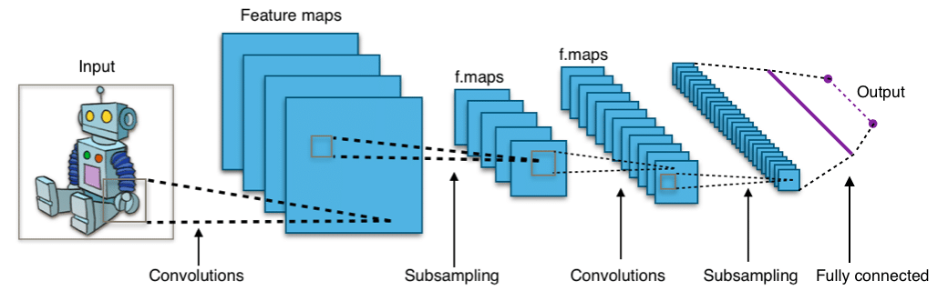
DEPLOYMENT:
Steps to Build Image Classification
Step 1: Setting up a Google Colab.
Step 2 : Import the libraries we'll need during our model building phase. ...
Step 3: Recall the pre-processing steps we discussed earlier. ...
Step 4: Creating a validation set from the training data. ...
Step 5: Define the model structure.

Slide 9
DOCUMENTATION AND REPORTING:
When documenting and reporting image classification using Convolutional Neural Networks (CNNs), a comprehensive paragraph should encompass the key aspects of the process.
This includes detailing the dataset used for training and testing, specifying the CNN architecture with its layers and activation functions, describing the training procedure including optimization techniques and data augmentation, presenting the evaluation metrics employed such as accuracy and F1 score, discussing the obtained results including any challenges faced, and concluding with insights for future research.
It's crucial to provide clear and concise information that allows readers to understand the methodology, outcomes, and implications of the CNN-based image classification task.

Slide 10
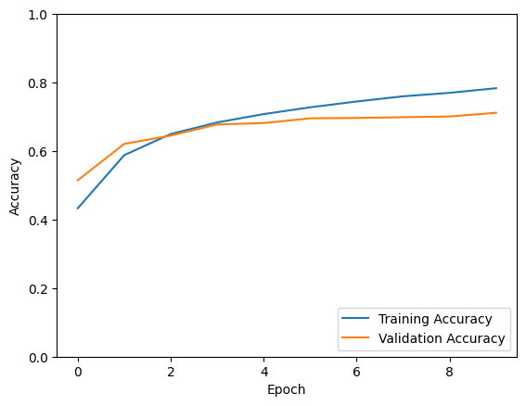
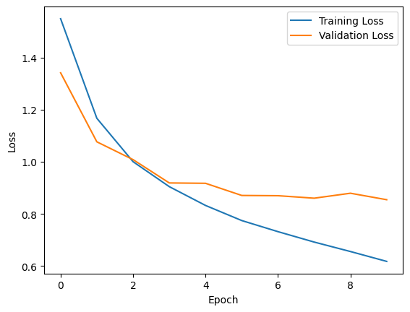
RESULT:

Slide 11
CONCLUSION:
In conclusion, Convolutional Neural Networks (CNNs) have proven to be highly effective for image classification tasks. Through this project, we demonstrated the power of CNNs in accurately categorizing images. By leveraging a dataset such as CIFAR-10 and implementing a CNN architecture with convolutional, pooling, and dense layers, we achieved commendable classification accuracy. The CNN was trained using optimization techniques like Adam, with the cross-entropy loss function. Data normalization and augmentation techniques further enhanced the model's performance. The evaluation metrics, including accuracy, provided insights into the model's effectiveness. Despite its success, challenges such as overfitting and computational complexity remain areas for improvement. Overall, this project underscores the significance of CNNs in image classification and opens avenues for future research to enhance model robustness and efficiency.

Slide 12
REFERENCES:
1.Dalal, N., Triggs, B.: Histograms of oriented gradients for human detection. In: IEEE Computer Society Conference on Computer Vision and Pattern Recognition, CVPR 2005, vol. 1, pp. 886–893. IEEE (2005).
2. Lowe, D.G.: Distinctive image features from scale-invariant keypoints. International Journal of Computer Vision 60(2), 91–110 (2004).
3. Sermanet, P., Kavukcuoglu, K., Chintala, S., LeCun, Y.: Pedestrian detection with unsupervised multi-stage feature learning. In: 2013 IEEE Conference on Computer Vision and Pattern Recognition (CVPR), pp. 3626–3633. IEEE (2013).

